Slide 1


PASIAN’ AW ZAKNA
Hearing God’s Voice in a Noisy World
Leitung gamlumna lak ah Pasian’ aw bang ci zak ding
Sia Sianpu
HMC Youth Camp
July 2026
Oklahoma, USA

Slide 2
PASIAN AW ZAKNA
The Big Question
Which voice am I following?
Every day, many voices tell us who we are, what is true, and how to live.
Culture says: “Follow your heart.”
Jesus says: “Follow Me.”
Culture says: “Create your own truth.”
Jesus says: “I am the truth.”
“The sheep that are My own hear My voice.”
John 10:27
Sia Sianpu • HMC Youth Camp 2026 • 2

Slide 3
PASIAN AW ZAKNA
Main Truth
God speaks — but not every voice is God’s voice.
We must know Jesus personally, listen with a surrendered heart, filter every message through Scripture, and obey through the power of the Holy Spirit.
01
God can speak to young people.
02
Hearing begins with salvation and relationship with Jesus.
03
Every voice must be tested by Scripture, fruit, prayer, and counsel.
04
God’s voice leads to obedience, holiness, and mission.
Sia Sianpu • HMC Youth Camp 2026 • 3

Slide 4
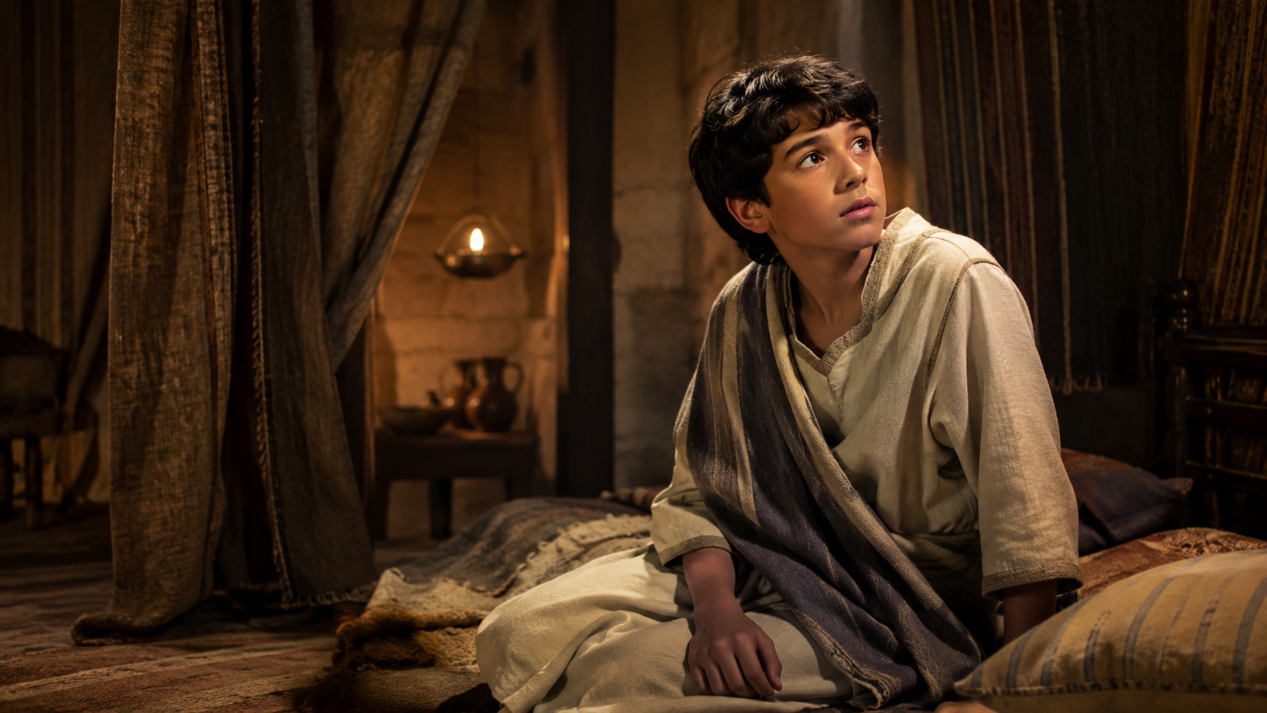
PASIAN AW ZAKNA
The Story of Young Samuel
“Samuel! Samuel!”
A young boy hears a voice at night. At first, he thinks Eli called him. After three times, Eli realizes the Lord is calling Samuel.
“Speak, for Your servant is listening.”
1 Samuel 3:10 • AMP key phrase
Sia Sianpu • HMC Youth Camp 2026 • 4

Slide 5
PASIAN AW ZAKNA
Context: A Spiritually Dark Generation
1 SAMUEL 3:1
Religious activity was present, but spiritual sensitivity was rare.
Priests, worship, sacrifices, and sacred routines still existed.
Eli’s sons were corrupt and dishonoring God.
The problem was not that God had lost His voice.
The problem was that people were not listening faithfully.
Important lesson:
God can speak to and use young people, even when the culture around them is spiritually confused.
“The word of the LORD was rare and precious.”
1 Samuel 3:1
Sia Sianpu • HMC Youth Camp 2026 • 5

Slide 6
PASIAN AW ZAKNA
God Uses Young People
Your age does not prevent God from speaking or using you.
Samuel
David
Jeremiah
1 Sam. 3:4–10
1 Sam. 16:11–13
Jer. 1:4–8
Timothy
Servant Girl
Boy’s Lunch
1 Tim. 4:12
2 Kings 5:2–3
John 6:8–13
“Let no one look down on you because of your youth.”
1 Timothy 4:12
Sia Sianpu • HMC Youth Camp 2026 • 6

Slide 7
PASIAN AW ZAKNA
Point 1: Hearing Begins with Knowing God
Being around church is not the same as knowing Jesus.
Samuel served near holy things, but he still needed to know the Lord personally.
Church attendance cannot save you.
Christian parents cannot save you.
Good behavior cannot save you.
Every person must respond to Jesus personally.
“Samuel did not yet know the LORD.”
1 Samuel 3:7
Sia Sianpu • HMC Youth Camp 2026 • 7

Slide 8
PASIAN AW ZAKNA
The Gospel in Five Simple Truths
Jesus saves by grace through faith.
Created
“God created man in His own image.”
Sinned
“All have sinned and continually fall short.”
Genesis 1:27
Romans 3:23
Death
“The wages of sin is death.”
Love
“While we were still sinners, Christ died for us.”
Romans 6:23
Romans 5:8
Faith
“By grace you have been saved through faith.”
Lord
“Confess with your mouth Jesus as Lord.”
Ephesians 2:8–9
Romans 10:9
“I am the Way and the Truth and the Life.”
John 14:6
Sia Sianpu • HMC Youth Camp 2026 • 9

Slide 9
PASIAN AW ZAKNA
Point 2: God Calls Personally
God knows your name, your story, and your calling.
God called Samuel by name.
God knows your thoughts and fears.
Culture may label you — God sees you.
Your identity begins with your Creator and Redeemer.
“The LORD called Samuel.”
1 Samuel 3:4
Sia Sianpu • HMC Youth Camp 2026 • 10

Slide 10
PASIAN AW ZAKNA
Point 3: Hearing Is Not the Same as Recognizing
A genuine experience may still be incorrectly interpreted.
Samuel heard the call, but first thought Eli was speaking.
He heard
He misread
He learned
real experience
wrong source
discernment
“Do not believe every spirit.”
“Test all things carefully.”
1 John 4:1
1 Thessalonians 5:21
Sia Sianpu • HMC Youth Camp 2026 • 11

Slide 11
PASIAN AW ZAKNA
Five Possible Sources of a Voice
Not every strong thought is God’s voice.
God
Self
People
Culture
Enemy
Truth • Holiness • Jesus
Fear • Desire • Pride
Advice • Pressure • Sincerity
Trends • Social media • Crowd
Lies • Accusation • Temptation
“Satan disguises himself as an angel of light.”
2 Corinthians 11:14
Sia Sianpu • HMC Youth Camp 2026 • 12

Slide 12

PASIAN AW ZAKNA
Why Every Voice Needs a Filter
Filtering protects discernment.
A message may look clean but still contain fear, pride, wrong motives, or misused Scripture.
Spiritual filtering does not quench the Holy Spirit. It helps us recognize His voice correctly.
Sia Sianpu • HMC Youth Camp 2026 • 13

Slide 13
PASIAN AW ZAKNA
Biblical Examples of Filtering Voices
The Bible teaches us to test the source.
Contradicts Scripture
'“It’s only the fruit from the tree in the middle of the garden that we are not allowed to eat. God said, ‘You must not eat it or even touch it; if you do, you will die.’
Eve
Gen. 3:1–6
Abraham & Sarah
Gen. 16:1–4
Impatience shortcut
Instead of patiently trusting God's promise, Sarai and Abram tried to fulfill God's plan through human effort by giving Hagar to Abram, resulting in pregnancy, pride, and conflict within the family.
Old Prophet
1 Kings 13
Spiritual claim conflicts
God requires complete obedience to His Word, for even a true servant of God faces serious consequences when he compromises by listening to human voices instead of the Lord's clear command.
Peter
Matt. 16:21–23
Kind but wrong advice
After Jesus foretold His suffering, death, and resurrection, Peter tried to prevent Him, but Jesus rebuked him for setting his mind on human concerns rather than God's redemptive plan.
Satan
Matt. 4:5–7
Misused Scripture
When Satan tempted Jesus to test God's protection by jumping from the temple, Jesus refused, declaring that God's people must trust Him without putting Him to the test.
Examined Scripture
'And the people of Berea were more open-minded than those in Thessalonica, and they listened eagerly to Paul’s message. They searched the Scriptures day after day to see if Paul and Silas were teaching the truth.’
Bereans
Acts 17:11
Jonah
Jon. 1:1–3
Wrong open door
'The Lord gave this message to Jonah son of Amittai: “Get up and go to the great city of Nineveh. Announce my judgment against it because I have seen how wicked its people are.” But Jonah got up and went in the opposite direction to get away from the Lord. He went down to the port of Joppa, where he found a ship leaving for Tarshish. He bought a ticket and went on board, hoping to escape from the Lord by sailing to Tarshish.’
Sia Sianpu • HMC Youth Camp 2026 • 14

Slide 14
PASIAN AW ZAKNA
The Filtering Formula
G.O.D.’S V.O.I.C.E.
A simple pattern for testing impressions, dreams, advice, prophecies, opportunities, and strong desires.
G
O
Objective Word
D
Gospel
Divine Character
S
Sanctification
V
O
Verify Source
Observe Fruit
I
Inquire Prayer
C
Examine & Obey
Consult Counsel
E
Sia Sianpu • HMC Youth Camp 2026 • 15

Slide 15

PASIAN AW ZAKNA
G — Gospel Test
Does it agree with the Gospel and honor Jesus?
Does it lead toward Jesus?
Does it affirm His death and resurrection?
Does it call for repentance and faith?
Does it change the gospel?
“He will glorify and honor Me.”
“Christ died for our sins… and rose again.”
John 16:14
1 Corinthians 15:3–4
Sia Sianpu • HMC Youth Camp 2026 • 16

Slide 16
PASIAN AW ZAKNA
O — Objective Word Test
Does it agree with Scripture correctly understood?
No dream, prophecy, feeling, vision, advice, opportunity, or
inner impression has authority to overturn Scripture.
John 17:17 — “Your word is truth.”
2 Timothy 3:16–17 — “All Scripture is God-breathed.”
Acts 17:11 — “Examining the Scriptures daily.”
Simple rule: God will never guide you to disobey what He has already written.
Sia Sianpu • HMC Youth Camp 2026 • 17

Slide 17
PASIAN AW ZAKNA
D — Divine Character Test
Does it reflect God’s character?
Holy
Truthful
Loving
Just
Merciful
Faithful
Wise
Pure
“God is not a man, that He should lie.”
“God cannot be tempted by evil.”
“God is not a God of confusion.”
Numbers 23:19
James 1:13
1 Corinthians 14:33
God will never direct you to lie, cheat, abuse, manipulate, commit sexual sin, or take revenge.
Sia Sianpu • HMC Youth Camp 2026 • 18

Slide 18
PASIAN AW ZAKNA
S — Sanctification Test
Will it make me more like Jesus?
“Continually pursue peace…and sanctification.”
The Spirit leads toward repentance, purity, humility, forgiveness, faithfulness, and growth.
God’s guidance leads toward holiness, not hidden sin.
Christlike transformation is the goal.
Hebrews 12:14
“This is the will of God, that you be sanctified.”
“Conformed to the image of His Son.”
1 Thessalonians 4:3
Romans 8:29
Sia Sianpu • HMC Youth Camp 2026 • 19

Slide 19
PASIAN AW ZAKNA
V — Verify the Source
What may actually be producing this thought?
Fear
Anger
Loneliness
Pride
Peer pressure
Temptation
Social media
My Preference
“Search me thoroughly, O God.”
“The heart is deceitful above all things.”
Psalm 139:23–24
Jeremiah 17:9
Simple prayer: “Lord, search my heart and expose wrong motives.”
Sia Sianpu • HMC Youth Camp 2026 • 20

Slide 20
PASIAN AW ZAKNA
O — Observe the Fruit
What kind of fruit will this produce?
Love
Joy
Peace
Patience
Kindness
Goodness
Faithfulness
Gentleness
Self-control
“By their fruit you will recognize them.”
“The fruit of the Spirit is love, joy, peace...”
Matthew 7:16
Galatians 5:22–23
Sia Sianpu • HMC Youth Camp 2026 • 21

Slide 21
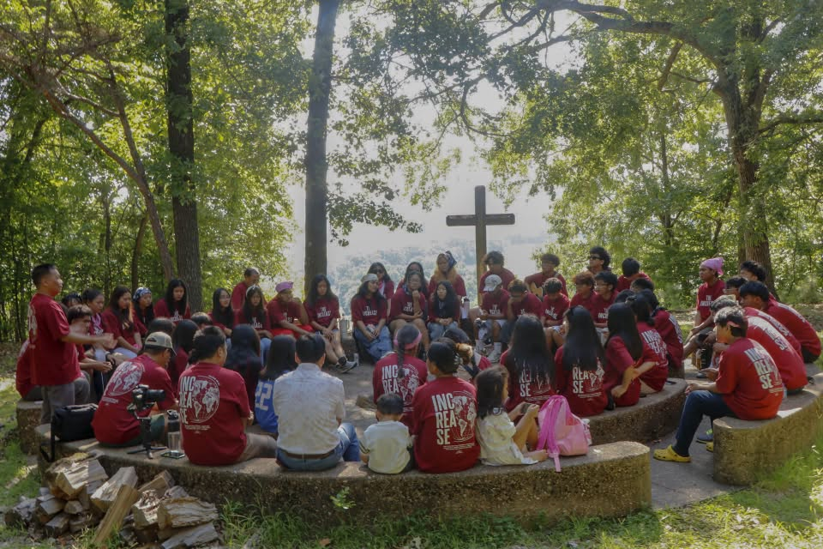
PASIAN AW ZAKNA
I — Inquire Through Prayer
Have I prayed with surrender and patience?
Ask God for wisdom.
Surrender your will.
Be still before God.
Do not invent an answer because waiting feels uncomfortable.
“If any of you lacks wisdom…ask of God.”
“Not My will,
but Yours be done.”
“Be still and know that
I am God.”
James 1:5
Luke 22:42
Psalm 46:10
Sia Sianpu • HMC Youth Camp 2026 • 22

Slide 22
PASIAN AW ZAKNA
C — Consult Mature Believers
Has this been tested through wise Christian counsel?
Samuel needed Eli.
You may need a parent, pastor, youth leader, teacher, or mature Christian mentor.
Ask people who are biblically grounded.
Seek correction, not just confirmation.
Do not ask many people until someone finally agrees with you.
“In an abundance of counselors there is victory.”
“Without consultation and wise advice, plans are frustrated.”
Proverbs 11:14
Proverbs 15:22
Sia Sianpu • HMC Youth Camp 2026 • 23

Slide 23
PASIAN AW ZAKNA
E — Examine & Engage in Obedience
Can I obey this without sin or irresponsibility?
Does the opportunity agree with Scripture?
Am I neglecting responsibilities?
Is the timing wise?
Will it glorify God?
Can I obey without compromise?
“Prove yourselves doers of the word.”
James 1:22
“The LORD directs his steps.”
“If you love Me, you will keep My commandments.”
Proverbs 16:9
John 14:15
Sia Sianpu • HMC Youth Camp 2026 • 24

Slide 24
PASIAN AW ZAKNA
Real-Life Examples
Feelings are real — but they are not final authority.
Dating
Social Media
“I feel peaceful” — but the relationship pulls me from purity and church.
A repeated message feels true, but popularity does not create truth.
Opportunity
“God told me”
More money is not automatic proof of God’s direction.
God’s voice should never be used to control, shame, or manipulate.
Sia Sianpu • HMC Youth Camp 2026 • 26

Slide 25
PASIAN AW ZAKNA
How to Hear God Practically
Nine simple steps
Know Jesus
Read Scripture
Pray Samuel’s prayer
1
2
3
Remove noise
Obey clear commands
Filter every message
4
5
6
Seek counsel
Watch the fruit
Obey clearly
7
8
9
“Your word is a lamp to my feet.”
“Faith comes from hearing.”
Psalm 119:105
Romans 10:17
Sia Sianpu • HMC Youth Camp 2026 • 27

Slide 26
PASIAN AW ZAKNA
Conviction vs. Condemnation
God corrects to restore; the enemy accuses to destroy hope!
Holy Spirit Conviction
Enemy Condemnation
Specific
Truthful
Hopeful
Leads to repentance
Vague
Hopeless
Shame-filled
Leads to hiding
John 16:8 • 2 Corinthians 7:10
Revelation 12:10 • Romans 8:1
“There is now no condemnation.”
Romans 8:1
Sia Sianpu • HMC Youth Camp 2026 • 28

Slide 27
PASIAN AW ZAKNA
Important Safety Rule
God will never tell you to harm, abuse, deceive, or commit evil.
Reject any voice that tells you to hurt yourself or others.
Reject any voice that tells you to keep abuse secret.
Reject any voice that tells you to commit sexual sin or break the law.
Tell a trusted adult or appropriate authority immediately.
“God cannot be tempted by evil.”
“Love does no wrong to a neighbor.”
James 1:13
Romans 13:10
Sia Sianpu • HMC Youth Camp 2026 • 29

Slide 28
PASIAN AW ZAKNA
Application
What does this mean for us?
Pre-Teens
Teens
Youth & Young Adults
Pray Samuel’s prayer. Ask questions.
Tell a trusted adult when confused.
Test emotion, relationships, and social media through Scripture.
Submit education, dating, money, career, and future plans to God.
“Speak, for Your servant is listening.”
1 Samuel 3:10
Sia Sianpu • HMC Youth Camp 2026 • 30

Slide 29
PASIAN AW ZAKNA
Personal Response
Take one honest step today.
One voice I need to stop listening to:
One truth from Scripture I need to believe:
One sinful habit I need to confess:
One person I can ask for help:
One person I should share the gospel with:
Sia Sianpu • HMC Youth Camp 2026 • 31

Slide 30
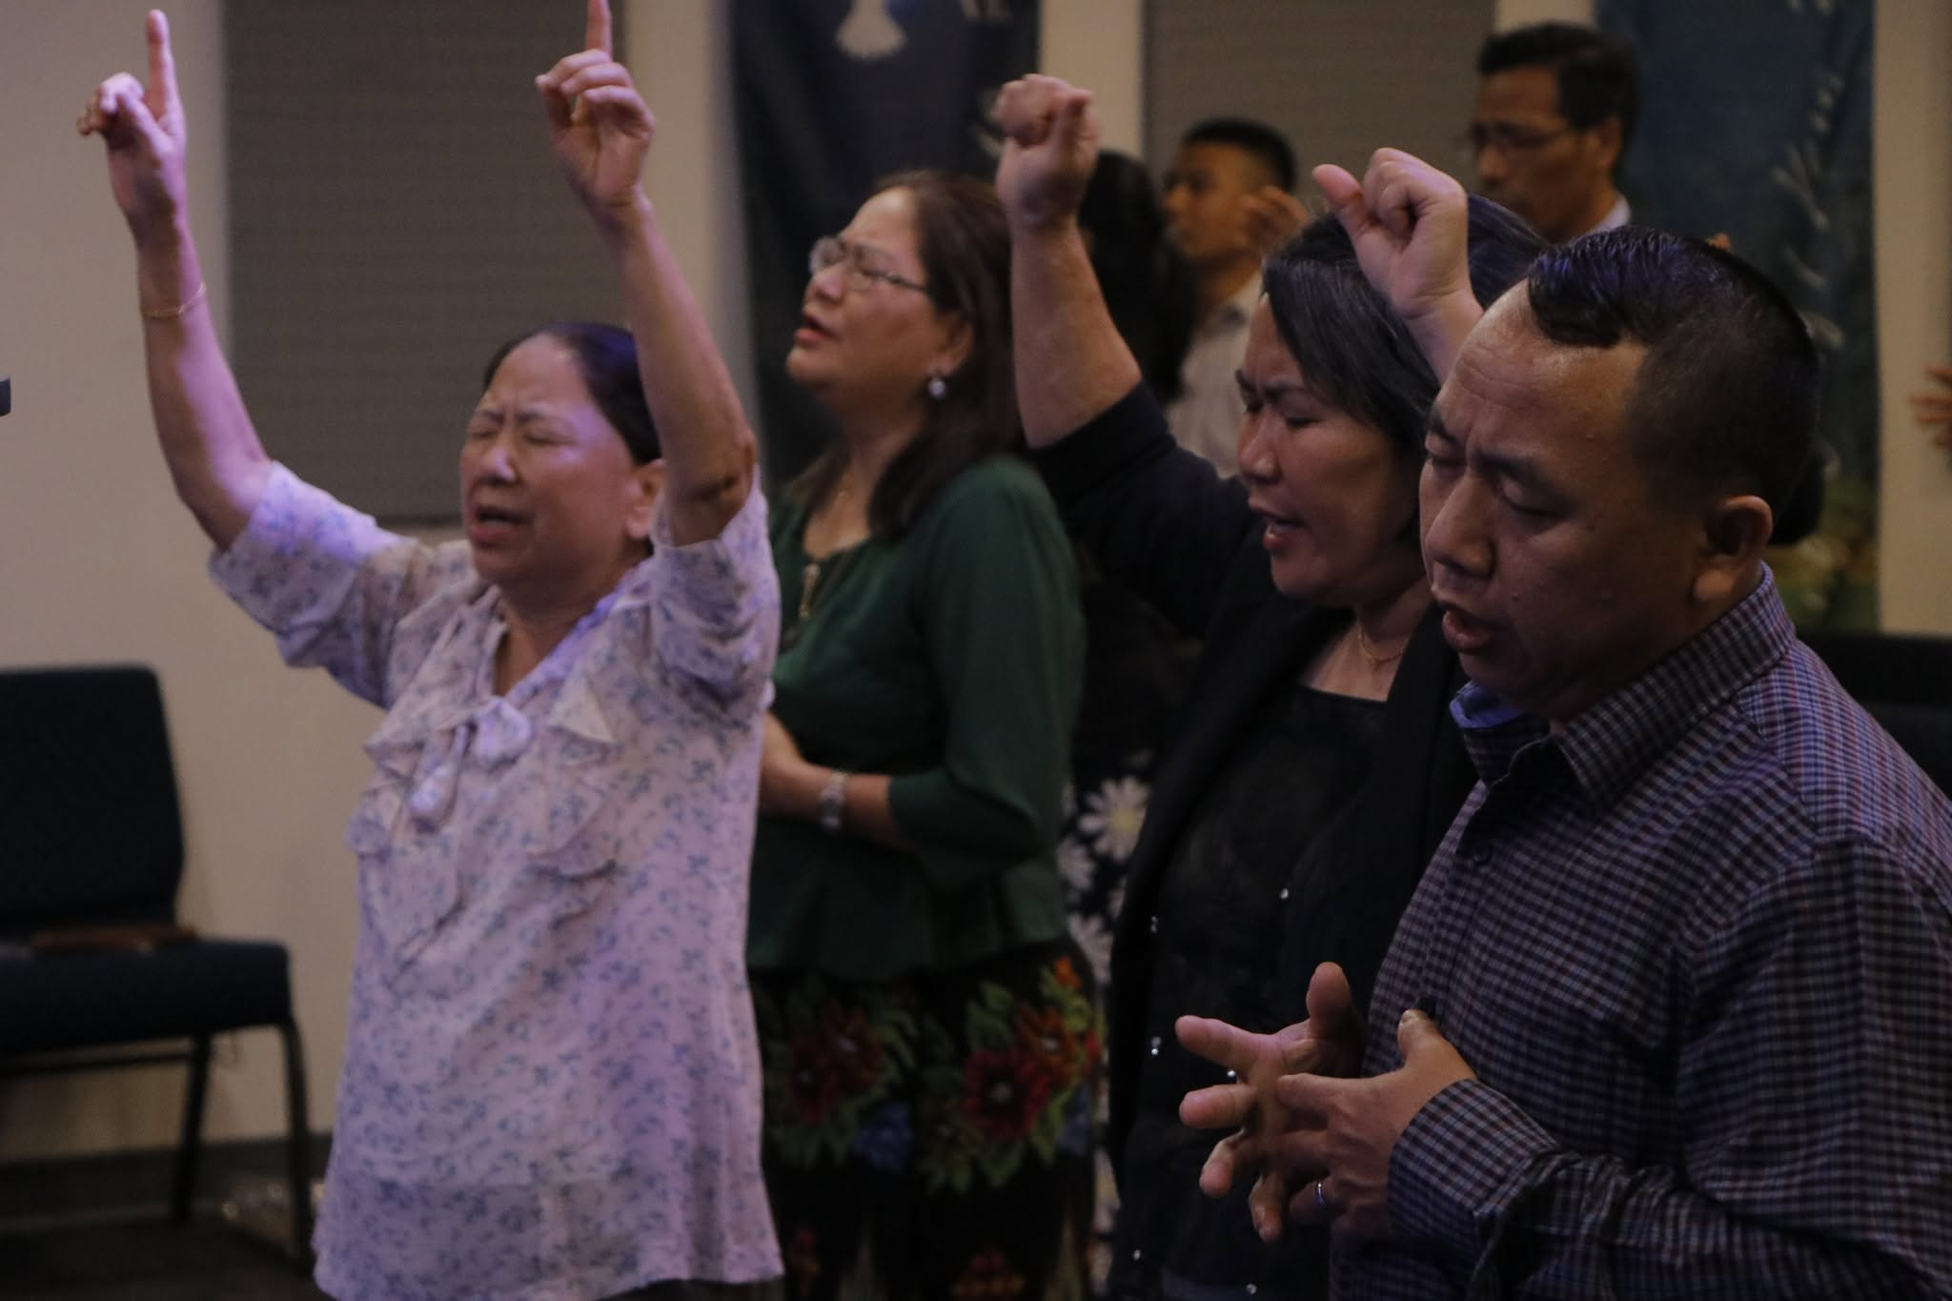
PASIAN AW ZAKNA
Altar Call
Come Respond to God
Salvation
Receive Jesus personally
Restoration
Return from wrong voices
Empowerment
Receive boldness and strength
Discernment
Learn to filter and test
Sia Sianpu • HMC Youth Camp 2026 • 34

Slide 31
PASIAN AW ZAKNA
Corporate Consecration Prayer
Speak, Lord, for Your servants are listening.
Father, thank You that You have spoken through Your Son, Your written Word, and the Holy Spirit.
Forgive us for listening more carefully to culture, fear, temptation, personal desire, and human approval than to You.
Renew our minds through Scripture.
Teach us to test every voice through the gospel, Your Word, Your holy character, sanctification, spiritual fruit, prayer, wise counsel, and faithful responsibility.
Holy Spirit, glorify Jesus, guide us into truth, convict us of sin, comfort us in pain, and empower us to obey. In Jesus’ name, amen.
“You will receive power…and you will be My witnesses.”
Acts 1:8
Sia Sianpu • HMC Youth Camp 2026 • 35

Slide 32
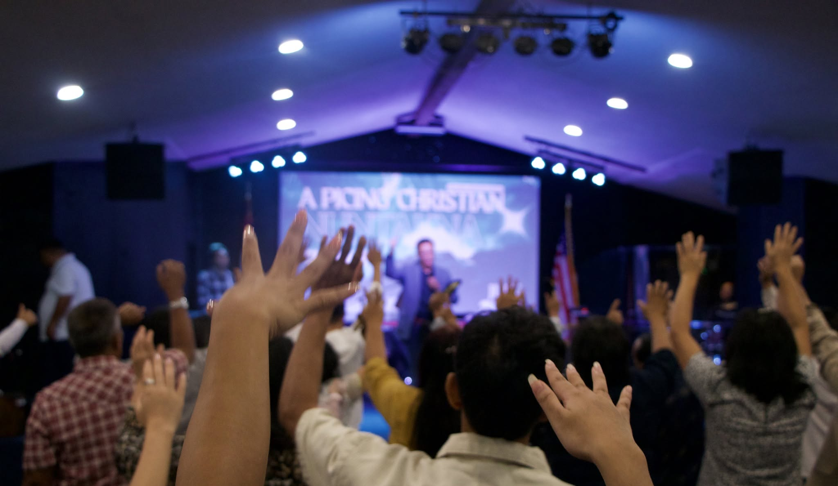
PASIAN AW ZAKNA
God speaks. Jesus saves. Scripture is truth.
Not every voice is God’s voice.
We will listen. We will filter. We will test.
We will obey. We will follow Jesus.
We will share the gospel by the power of the Holy Spirit.
Sia Sianpu • 2026 HMC Youth Camp

